Slide 1
US Flights Data
Nathan David & Sarabjit Matharu
Lighthouse Labs

Slide 2
Project Goals
Our data set contained monthly domestic flight records from 2000 to 2009.
Parameters used are Origin, Destination, Origin City, Destination City, Passengers, Seats, Flights, Distance, Fly Date, Origin Population, Destination Population.
Goal of this project is to find out patterns of flights in between various places. Which years and which regions we have more flights in & how different factors are contributing number of flights.

Slide 3
Process
Cleaning data includes removing any duplicate values from this data set. As there is no column that can be used as a unique key for this data set so we created a new column named ID by combining following columns - Origin City + Destination City + Passengers + Fly Date.
in this data set We have 591438 rows(including Duplicates) & 14 columns. Then we checked information of dataframe to view column names & rows of data set.A check is also performed to see if there is any null or NaN vlaue present within dataset.
Then a duplicate check was performed. We had 10375 duplicate rows. We have 581063 rows after cleaning up.
After cleaning of data was done, next step was to import all libraries. Then create a dataframe to see all the columns & a glimpse of rows.

Slide 4
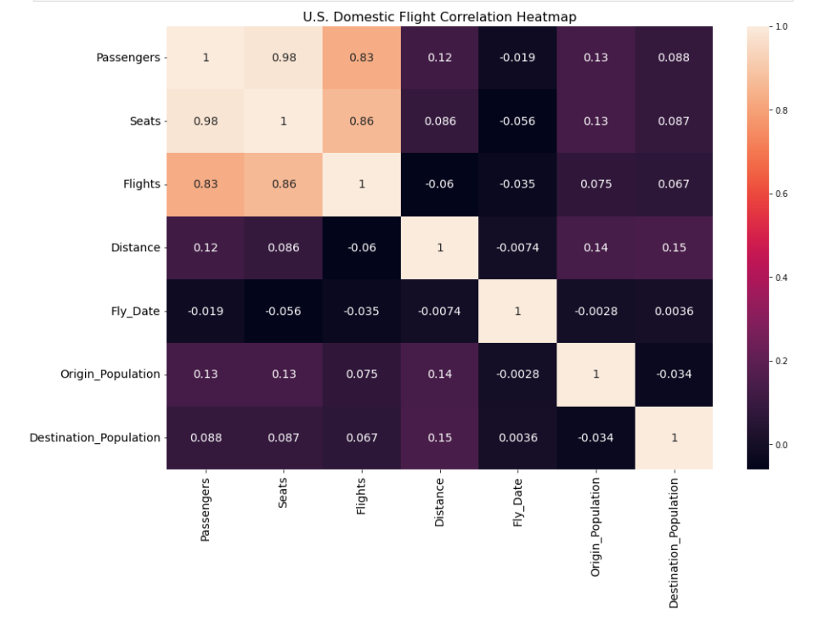

Slide 5
Strong Positive Correlation: Passengers and Seats, Passengers and Flights Strong Negative Correlation: Passengers and Fly Date, Seats and Fly Date, Flights and Fly Date, Distance and Fly Date
Positive & Negative Correlation

Slide 6
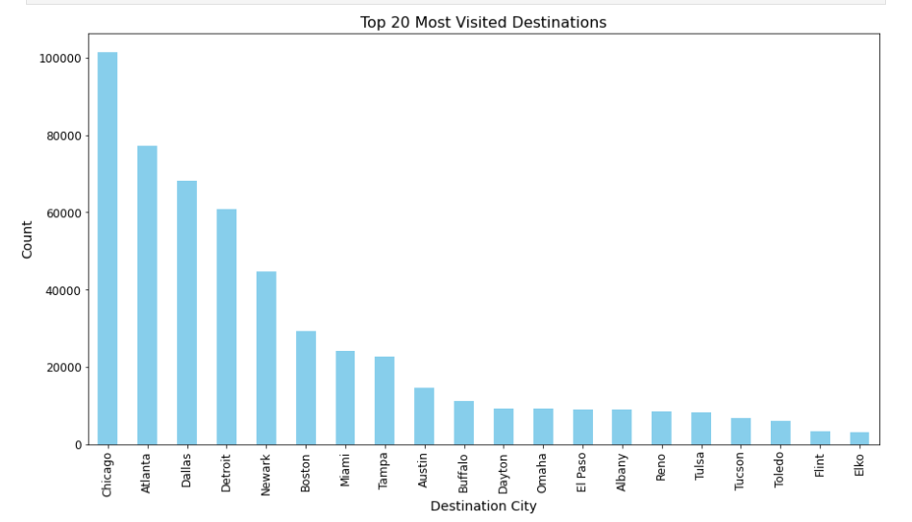
Most visited destination is Chicago followed by Atlanta & Dallas.

Slide 7
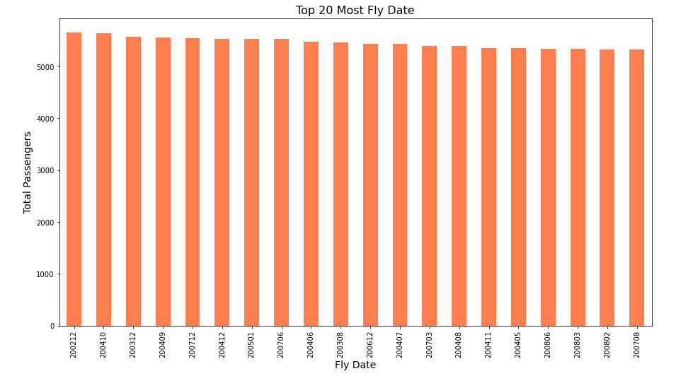
Top 20 most Fly Dates

Slide 8
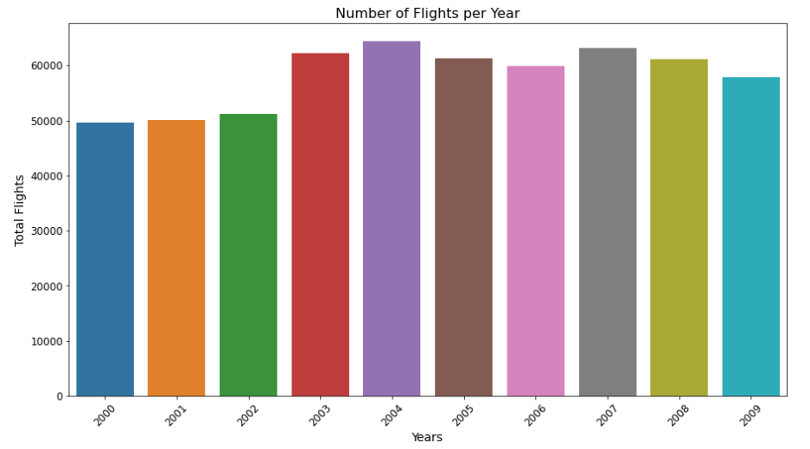
We have most number of flights in 2004 followed by 2007.

Slide 9
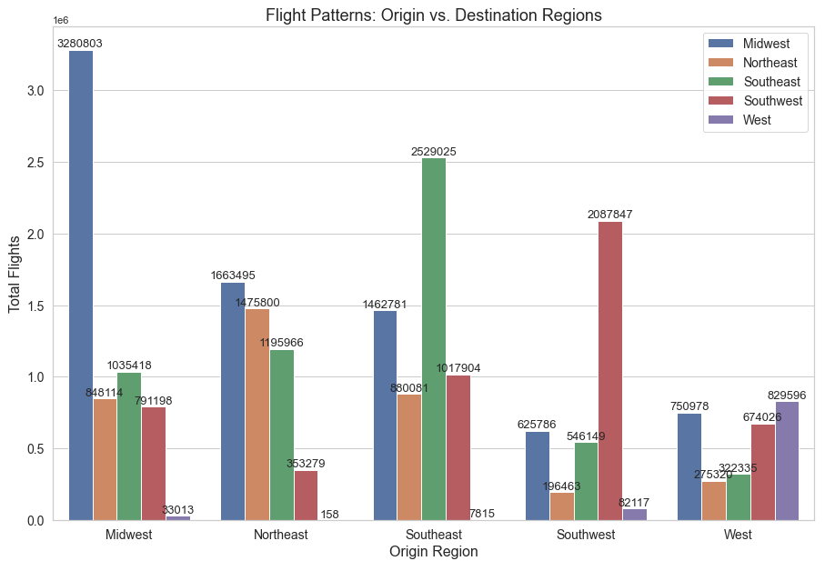
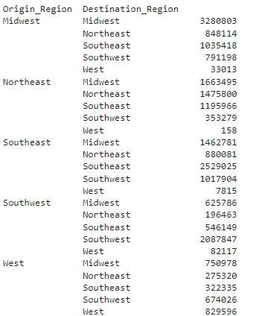

Slide 10
When looking as regions we have most number of flights from Midwest to Midwest.
A higher volume of flights connects cities within the Midwest, Southeast, Southwest, and West regions.
However, in the case of the Northeast region, there is a higher volume of flights connecting it to the Midwest region rather than within the Northeast itself.
There are less travelling in within the West region and to other regions.

Slide 11
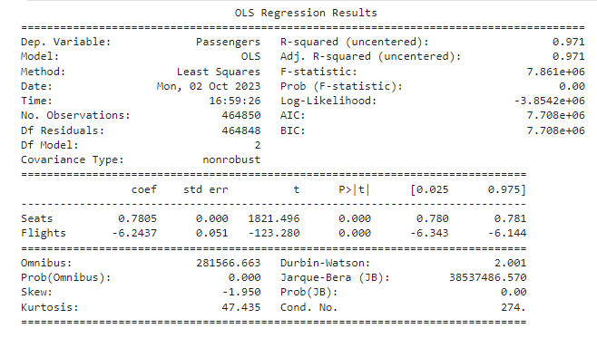
Regression Model

Slide 12
Regression Model
Both 'Seats' and 'Flights' have very low p-values (close to zero), indicating that they are statistically significant predictors. Overall, the model explains a substantial portion of the variance in 'Passengers,' and both 'Seats' and 'Flights' are statistically significant predictors.
However, some aspects of model fit and distribution of residuals may need further investigation, particularly the non-normality of residuals indicated by the Jarque-Bera test.

Slide 13
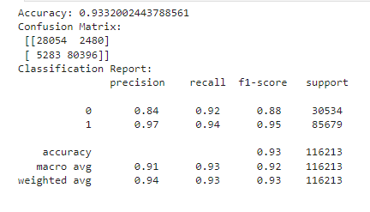
Classification Model
The classification model has a high accuracy of approximately 93.32%. It performs well in precision, recall, and F1-score for both classes, indicating that it can effectively distinguish between them (0 and 1). The classification report provides a detailed breakdown of the model's performance for each class.

Slide 14
Based on the analysis of flight patterns from 2000 to 2009, we observe the following:
A higher volume of flights connects cities within the Midwest, Southeast, Southwest, and West regions.
However, in the case of the Northeast region, there is a higher volume of flights connecting it to the Midwest region rather than within the Northeast itself.
There are less travelling in within the West region and to other regions.

Slide 15
Thank You

